Slide 1

Stock Market Predictions with Artificial Intelligence - Group Project
Lange, Jennifer Sissi
Jade Lu
Kerk zong zhe
Lo hoi ching, gin

Slide 2

Content
Topic and goal
Dataset, Dataset extraction and analysis
Function of the models
Concept of analysis and evaluation of the models
Result
Conclusion

Slide 3

Topic and goal
The topic of our project was to create an AI model that can predict whether the stock market will rise or fall.
The goal is to help users make better decisions on buying or selling their stocks based on our model.
https://dutchuncles.in/aspire/stock-market-101/

Slide 4



Datasets
The stock datasets used to train and test our AI model were Tesla, Samsung, and Twitter.
Tesla: June 2010 - Feb. 2020
Samsung: Jan. 2000 – May 2022
Twitter: Nov. 2013 – Oct. 2022
The original features used were date, open, high, low, close, volume.
Training uses 70% of the data and 30% is used for testing.
Tesla logo
Samsung logo
Twitter logo

Slide 5
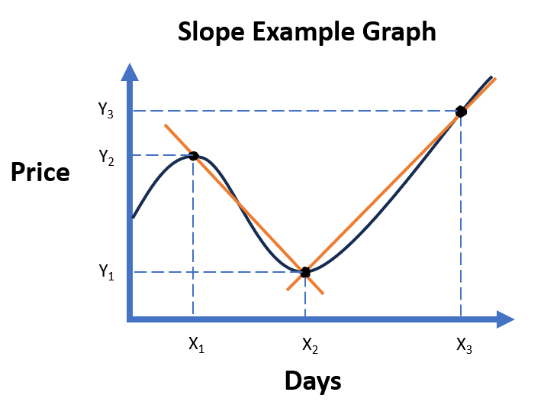
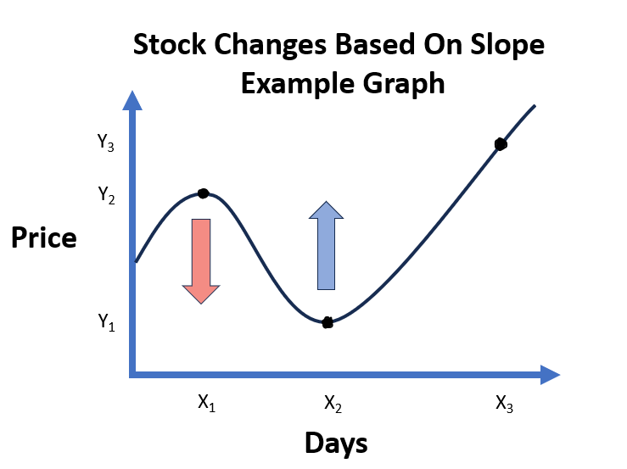
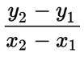
Data extraction
The modified features created and used:
Slope/rate of change
average slope
number of rises and falls
difference between high and low
average difference between high and low
difference between open and close
average difference between open and close
labels
The main formula used was this:

Slide 6

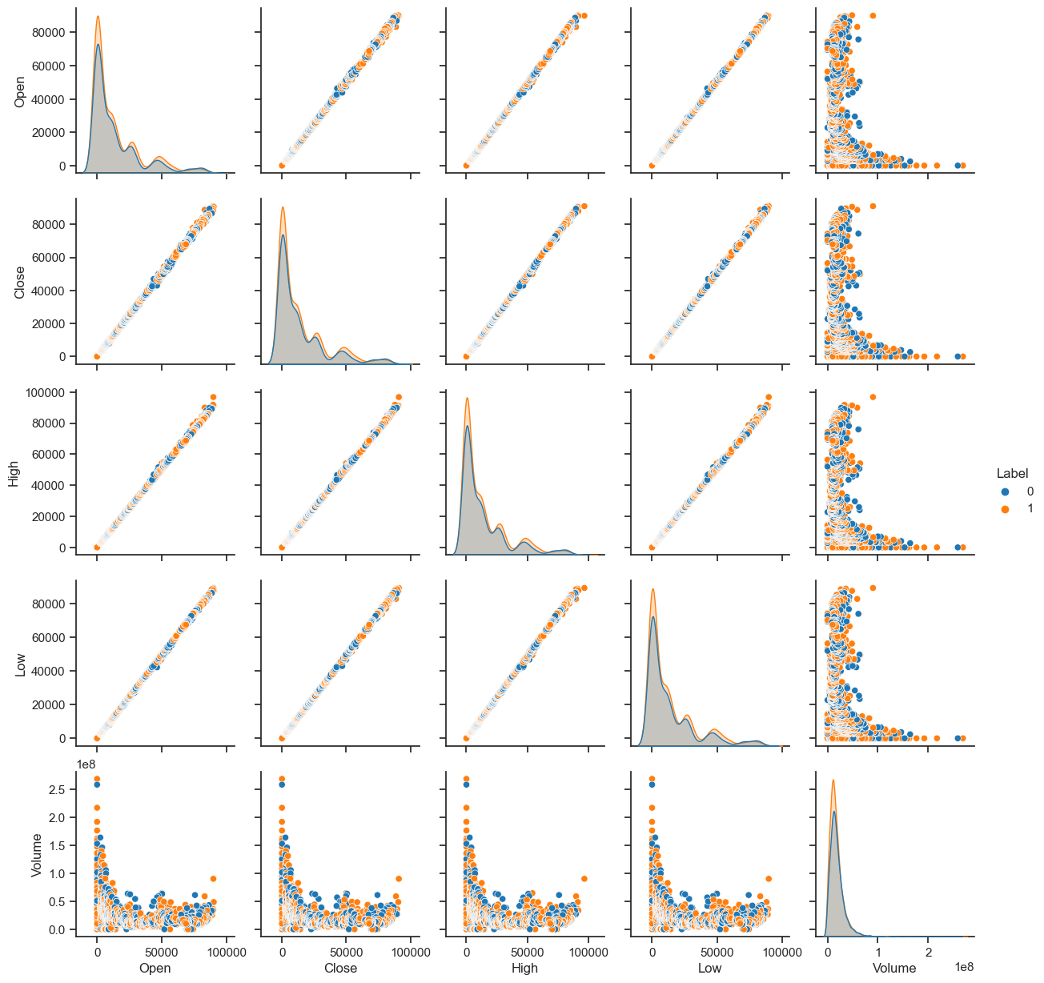
Data analysis

Slide 7
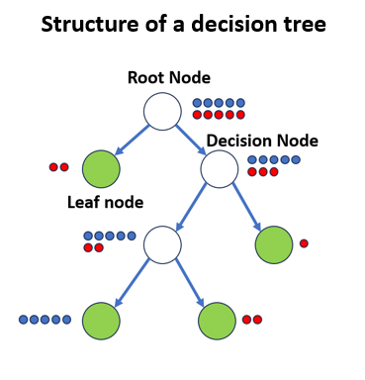
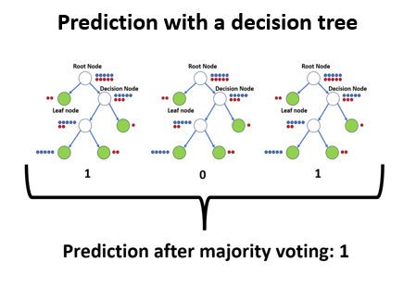
Function of the model

Slide 8
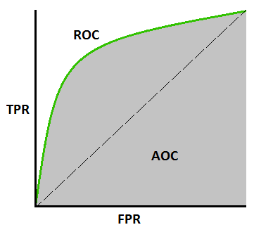
Concept of analysis and evaluation of the models
Concept for analysing the model
Receiver Operating Characteristic (ROC) curve
Decision Tree vs Random Forest
Forecast for a specific time in the future
Different versions of the dataset
Demonstration of the model created from scratch
Comparison of 16 different models.
https://towardsdatascience.com/understanding-auc-roc-curve-68b2303cc9c5

Slide 9
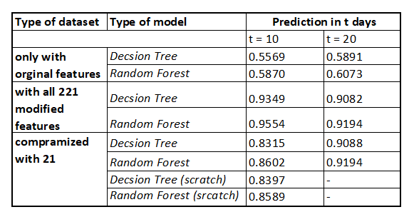
Results

Slide 10
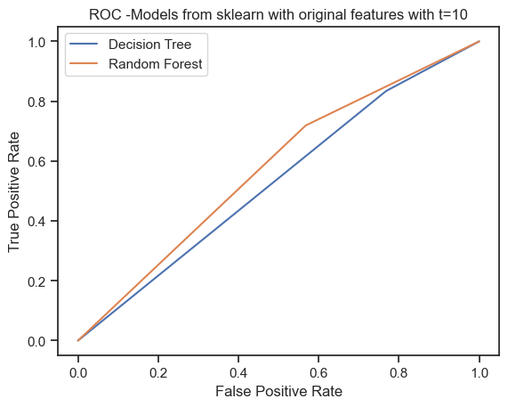
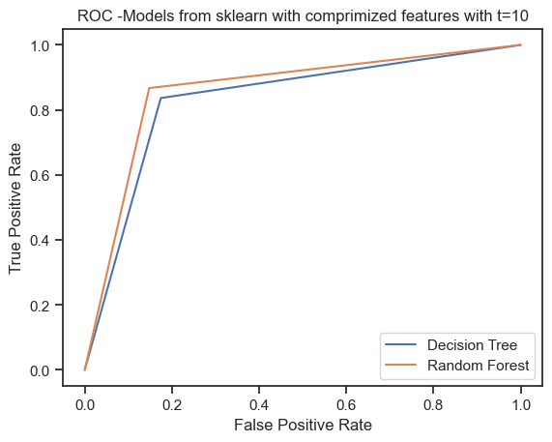
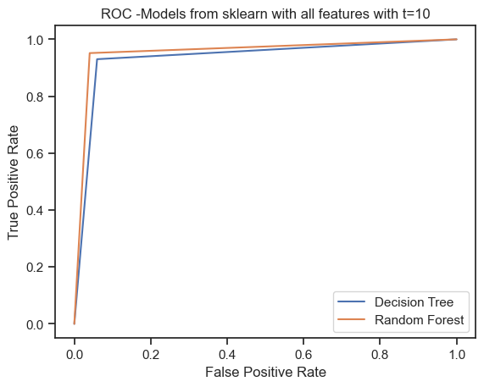
Results

Slide 11
Conclusion
No perfect model for every circumstances
Quality of model depends on:
Input dataset
Prediction target
A larger number of features does not equal better accuracy.

Slide 12

Thank you for your attention! Do you have any questions?
https://dev.to/theinterviewsage/do-you-have-any-questions-for-me-facebook-behavioral-jedi-interview-series-1dpa

